Slide 1
Lecture Slide - 4
Chapter 5: Series dc Circuits (Part 2)
*
‹#›

Slide 2
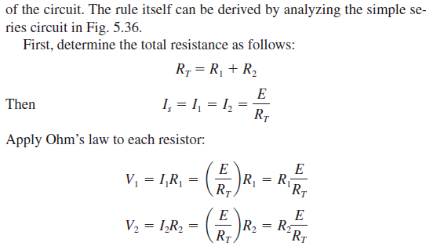
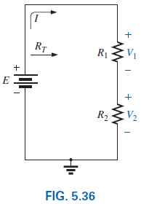
5.7 Voltage Divider Rule (VDR)
*
‹#›
Notes:
‹#›

Slide 3
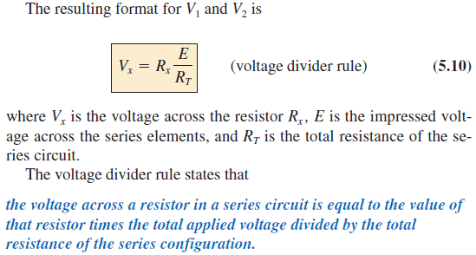
5.7 Voltage Divider Rule
*
‹#›
Notes:
‹#›

Slide 4
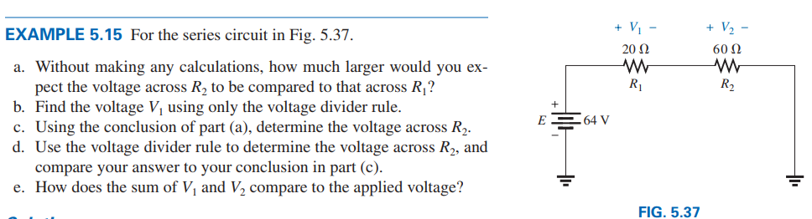


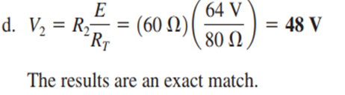

*
‹#›

Slide 5

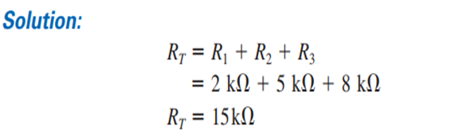
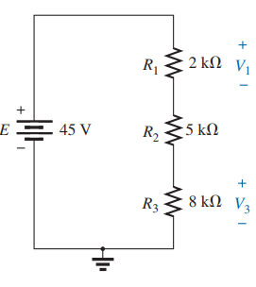
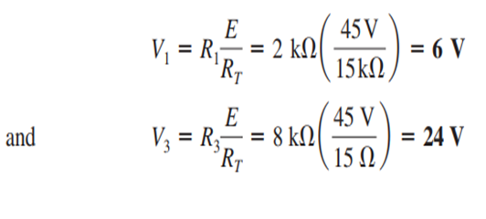
Example 5.17, 5.18
*
‹#›

Slide 6
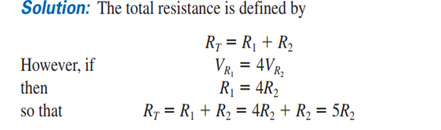
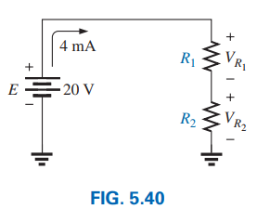
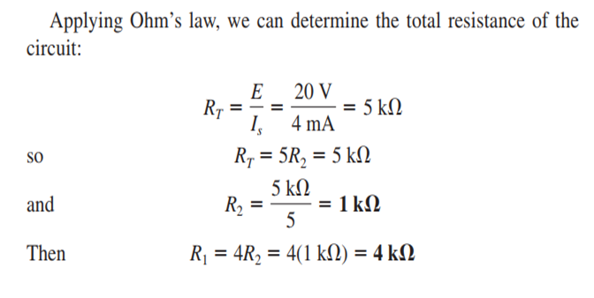
Example 5.19: Determine R1 and R2 when the voltage across R1 will be four times the voltage across R2;
*
‹#›

Slide 7
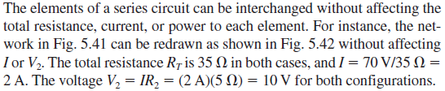
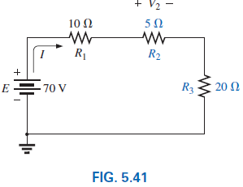
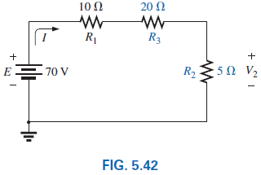
5.8 Interchanging Series Elements
See Example: 5.20
*
‹#›
Notes:
‹#›

Slide 8
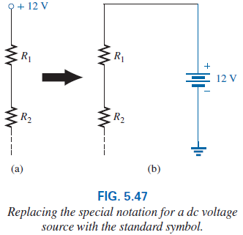
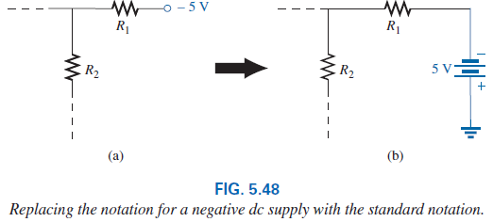
5.9 Voltage Sources
On large schematics where space is at a premium and clarity is important, voltage sources may be indicated as shown in Figs. 5.47(a) and 5.48(a) rather than as illustrated in Figs. 5.47(b) and 5.48(b).
*
‹#›
Notes:
‹#›

Slide 9
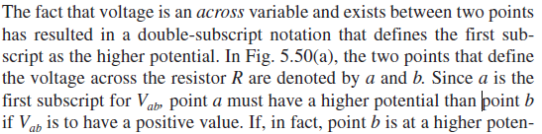
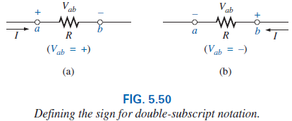
5.9 Double-Subscript Notation
*
‹#›
Notes:
‹#›

Slide 10
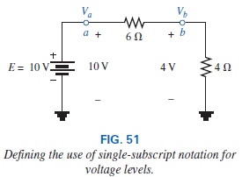
5.9 Single-Subscript Notation
If point b of the notation Vab is specified as ground potential (zero volts), then a single-subscript notation can be used that provides the voltage at a point with respect to ground.
The single-subscript notation Va specifies the voltage at point a with respect to ground (zero volts).
*
‹#›
Notes:
‹#›

Slide 11
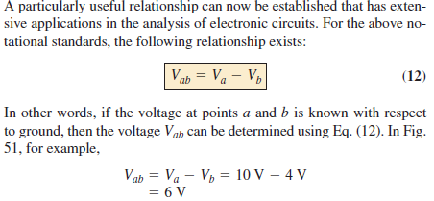
5.9 General Comment
Examples: 5.21 – 5.27
*
‹#›
Notes:
‹#›

Slide 12
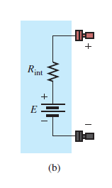
5.10 Voltage Regulation and the Internal Resistance of Voltage Sources
When you use a dc supply such as the generator, battery or supply, you initially assume that it will provide the desired voltage for any resistive load you may connect to the supply.
In other words, if the battery is labeled 1.5 V or the supply is set at 20 V, you assume that they will provide that voltage no matter what load we may apply.
Real-world supply has an internal resistance in series with the idealized voltage source as shown in Fig. 5.65(b).
The resistance level depends on the type of supply, but it is always present.
*
‹#›
Notes:
‹#›

Slide 13
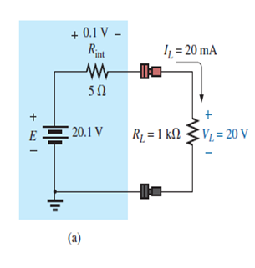
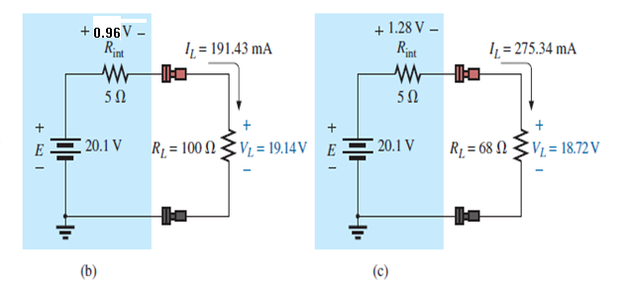
R_{T} = R_{int} + R_{L} = 5 Ω + 1 kΩ = 1.005 k Ω
I = E / R_{T} = 20.1 V / 1.005 k Ω = 20 mA
V_{L} = I_{L} x R_{L} = 20mA x 1 kΩ = 20 V
Calculate V_{L}, if R_{L} = 100 Ω?
Calculate V_{L}, if R_{L} = 68 Ω?
*
‹#›
Notes:
‹#›

Slide 14
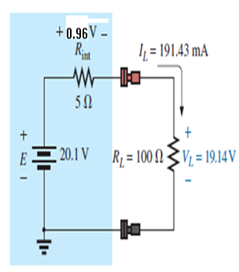
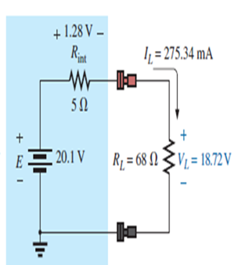
The 1 kΩ load is replaced by a 100 Ω resistor.
l_{L}= E/R_{T} = 20.1 V/105 Ω = 191.43 mA,
V_{L} = I_{L}R = (191.43 mA)(100 Ω)=19.14 V, a drop of 0.96 V in the internal resistor.
A 68 Ω load is applied, and the current increases substantially to 275.34 mA with a terminal voltage of only 18.72 V. This is a drop of 1.28 V from the internal resistor.
In summary, as the current drawn from the supply increases, the terminal voltage continues to drop.
*
‹#›

Slide 15
5.13 General characteristics of the series configuration
First, if one element of a series combination of elements should fail, it will disrupt the response of all the series elements.
If an open circuit occurs, the current will be zero.
If a short circuit results, the voltage will increase across the other elements, and the current will increase in magnitude.
Second, for the same source voltage, the more elements you place is series, the less the current and the less the voltage across all the elements of the series combination.
Last, the current is the same for each element of a series combination, but the voltage across each element is a function of its terminal resistance.
*
‹#›
Notes:
‹#›

Slide 16
5.13 Applications
Series Control
Holiday Lights
Microwave Oven
Series Alarm Circuit
*
‹#›
Notes:
‹#›

Slide 17
Chapter 6: Parallel dc Circuits
*
‹#›

Slide 18
Contents:
Objectives
Introduction
Parallel Resistors
Total Resistance and Conductance
Parallel Circuits
Power Distribution in a Parallel Circuit
*
‹#›

Slide 19
Objectives
Become familiar with the characteristics of a parallel network and how to solve for the voltage, current, and power to each element.
Develop a clear understanding of Kirchhoff’s current law and its importance to the analysis of electric circuits.
Become aware of how the source current will split between parallel elements.
*
‹#›

Slide 20
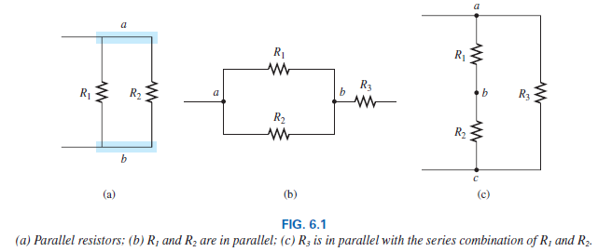
6.2 Parallel Resistors
Two elements, branches or networks are in parallel if they have two points in common.
*
‹#›

Slide 21
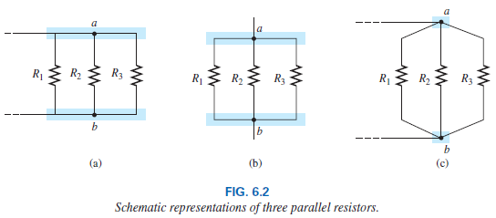
6.2 Parallel Resistors
On schematics, the parallel combination can appear in a number of ways, as shown in Fig. 6.2. The three resistors are in parallel. They all have points a and b in common.
*
‹#›

Slide 22

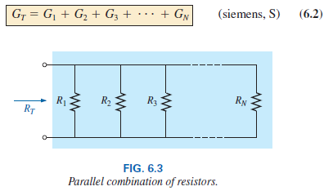
6.2 Total Resistance and Conductance
For resistors in parallel as shown in Fig. 6.3, the total resistance is determined from the following equation:
Since G = 1/R, the equation can also be written in terms of conductance levels as follows:
*
‹#›

Slide 23

6.2 Total Resistance and Conductance
The equation of total conductance is an exact match in format with the equation for the total resistance of resistors in series: R_{T} = R₁ + R₂ + R₃ + . . . + R_{N}.
This duality results in when you are able to write one equation to the other simply by interchanging R and G.
In general, however, when the total resistance is desired, the following format is applied:
*
‹#›

Slide 24
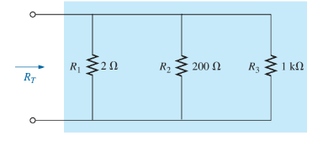
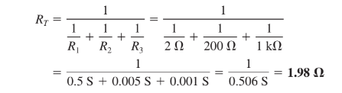
Example 6.1
*
‹#›

Slide 25
6.2 Examples
Example 6.2, 6.3, 6.4
In general, the total resistance of parallel resistors is always less than the value of the smallest resistor. This is particularly important when you want a quick estimate of the total resistance of a parallel combination.
In addition, if the smallest resistor of a parallel combination is much smaller than the other parallel resistors, the total resistance will be very close to the smallest resistor value (Example 6.2).
The total resistance of parallel resistors will always drop as new resistors are added in parallel, irrespective of their value which is the opposite of series resistors, where additional resistors of any value increase the total resistance.
*
‹#›

Slide 26
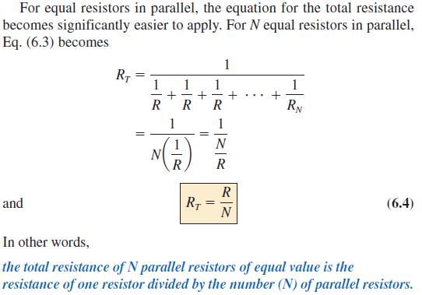
6.2 Equal Resistors in Parallel
Example 6.5
*
‹#›

Slide 27
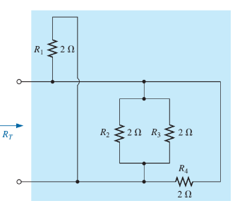
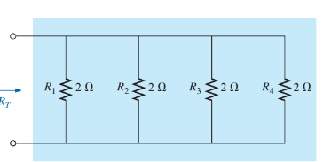
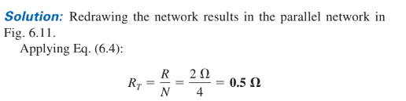
*
‹#›

Slide 28
Thank You
*
‹#›

